Slide 1


Hola, This is Soumyadip
Hola,This is Prasun Das
Just a Student at UEMK
SDE Intern @ Aberrantz
Ex-Full Stack Web Developer@ Quordnet Academy | SWE Freelancer @ OYO
Trainer |Open Source Contributor | GSSOC Participant
git add
SDE Intern @Bajaj Finserv Health
Cloud & Microservices Developer
Distributed Mobile Networking Researcher
Teaching Assistant at Multiple Organizations

Slide 2

Course Module
Introduction to Web Development
HTML
CSS with Web Design
Bootstrap and other styling Framework
Git and GitHub
JavaScript
jQuery
Firebase
PHP
Database (SQL and NoSQL)
Ajax
Wordpress
Node with Express
@s_oumyadip

Slide 3
Course Module
Ejs and Rest api
React
Vue
Angular
Web Hosting
Bonus concepts (Devops, system architecture, etc)
@s_oumyadip

Slide 4
What is Web Development ?
Notes:
So what would you do with it? We are here to help you answer that question
Lets start with a brief introduction about Technobuzz.
It’s a workshop series to help you shape your career and decide a career path. It will also help you understand how technology can help your business.
We will first cover an introduction to a field of technology which is for today, Cloud Computing, and discuss career opportunities available in the field and we’ll provide you with the learning resources for you to move forward after this session. We will have a hands-on session tomorrow for more concrete understanding of what you learn today.
Enough of Technobuzz, now lets dive into cloud computing

Slide 5


What is Web Development?
Web development is the work involved in developing a
Web site for the Internet (World Wide Web) or an intranet
(a private network).^{[1]} Web development can range
from developing a simple single static page of plain text to complex web applications, electronic businesses,
and social network services.

Slide 6
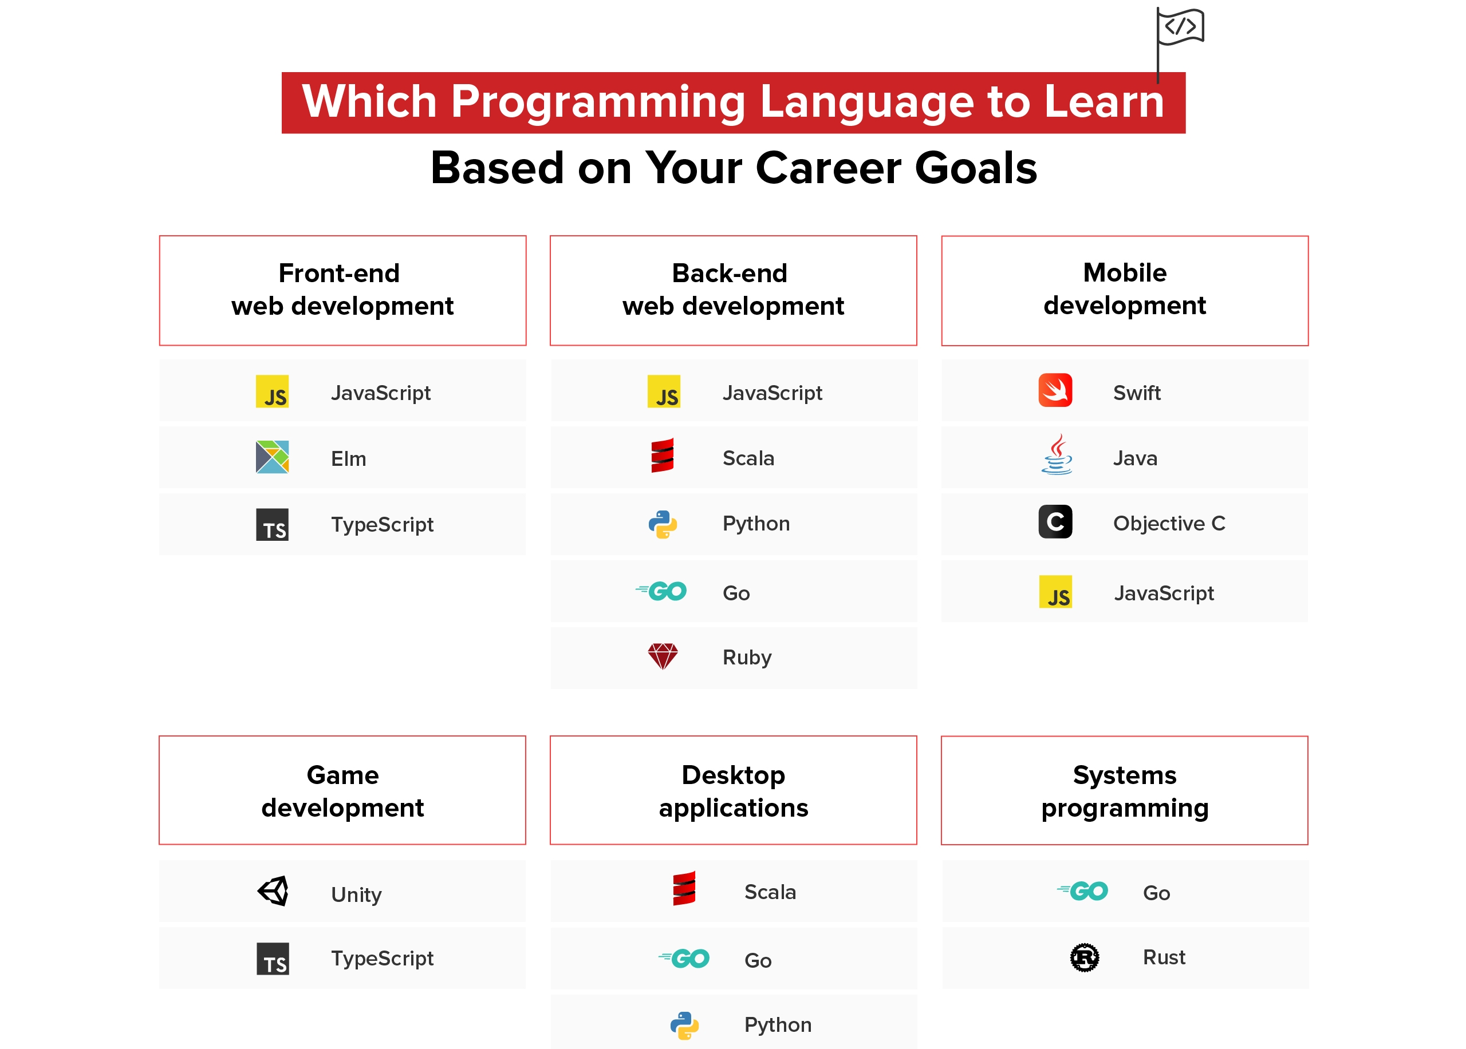
Web Career Goals

Slide 7

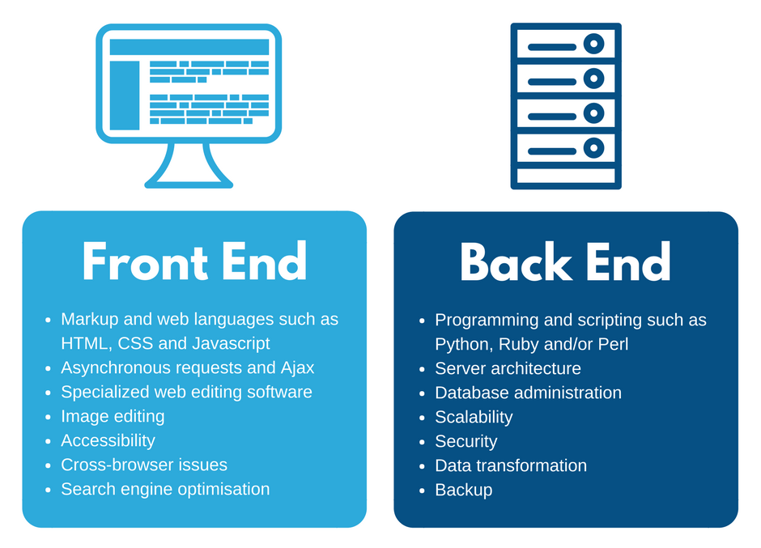






Slide 8
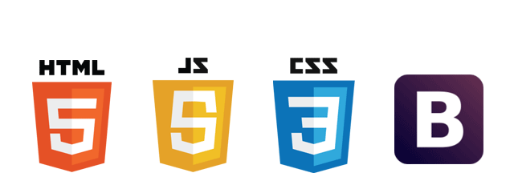
Frontend Components

Slide 9
Let’s Create a website using Html, CSS, JS & Bootstrap & Deploy it *_*

Slide 10
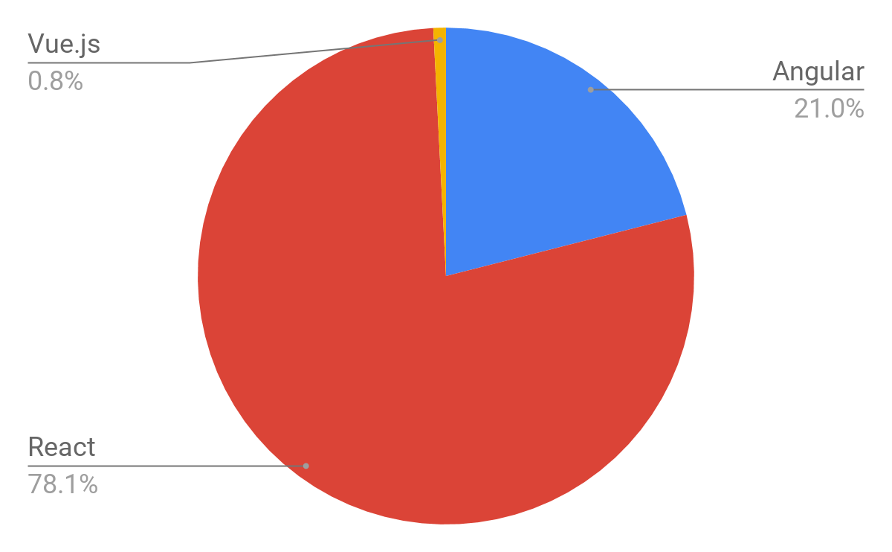
Frontend Market Trend

Slide 11
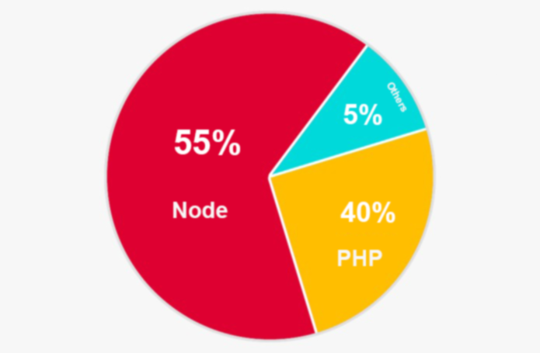
Backend Market Trend

Slide 12

What’s Next?
Do some Hands-On

